Slide 1
Cloud Extended Planning and Analysis Solutions
Market Assessment and Competitive Landscape
Discussion Materials
November 2024

Slide 2
EXECUTIVE SUMMARY
The xP&A market is large and growing rapidly, driven by advancements in AI and evolving corporate needs like real-time reporting. The market is divided between companies serving high lucrative large enterprise accounts—which face challenges with complex integrations—and players focusing on the fragmented SME sector, which presents significant growth opportunities.
M&A activity is likely to increase, driven by private equity firms exiting investments and a consolidation play as competitors aim to establish leadership in the SME space.
New players like Pigment are innovating by reducing setup barriers and offering user-friendly solutions, but they face challenges scaling beyond large enterprises. Meanwhile, large IT players like SAP could enter the SME market and lead consolidation efforts
Key takeaways
The xP&A market is poised for substantial growth of +15% p.a. from 2023 to 2028, driven by technological advancements, increasing cloud adoption, and a heightened focus on data security and real-time analytics.
With the market projected to grow from $14.4 bn in 2023 to $29.5 bn by 2028, key trends such as AI/ML integration, cloud migration, and ESG reporting are shaping the future landscape.
Within the corporate segment, small and medium companies are expected to grow fastest due to increased quantity and penetration rates. This segment is expected to represent ~60% of the market in 2028, up from ~40% in 2023.
Market
The competitive environment is diverse, featuring established IT service companies and agile new entrants leveraging innovative solutions to disrupt the market.
Key purchasing criteria for customers include cost efficiency, seamless integration, robust functionality, and vendor reputation, highlighting the diverse need of various market segments
There is a clear consolidation play waiting to happen within the SME segment as currently the market is highly fragmented with larger players not allocating many resources to serve such segment
Moreover, high M&A activity is expected as many players in the industry are PE-backed companies, reaching the end of the fund’s holding period
Competitive Landscape
Aqmen was founded by seasoned industry professionals and a world-renowned academic, with the mission to empower better decision making by streamlining repetitive, low-value tasks and enabling people to focus on what truly matters: thinking.
This report was developed by Aqmen's team as part of Lio’s training, developing its ability to tackle complex problems, provide actionable insights, and generate ready-to-use outputs efficiently.
About Aqmen
2

Slide 3
Agenda
Market Overview
Competitive Landscape
About Aqmen

Slide 4
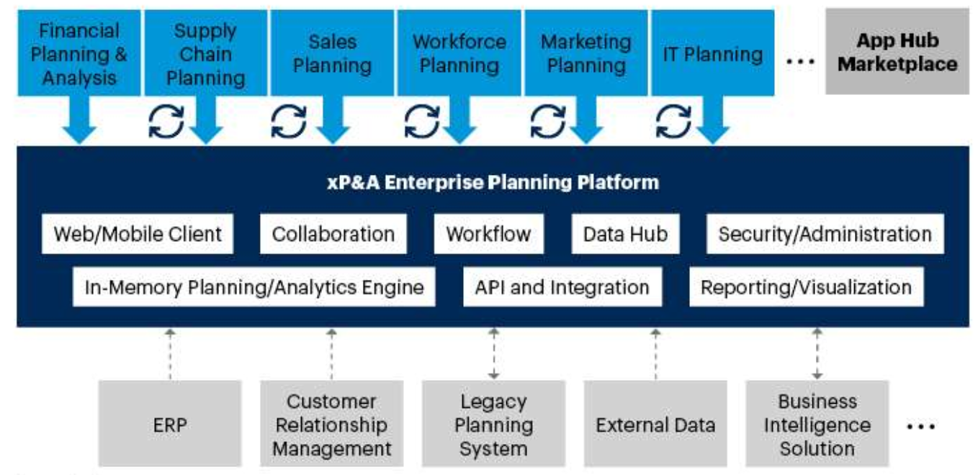
Cloud Extended Planning and Analysis Solutions market (xP&A) represents a maturing approach to enterprise planning
<(15%)
(15%)-(5%)
(5%)-5%
5%-15%
>15%
Overview of the extended xP&A market attributes
Market definition
xP&A is platform-centric enterprise planning strategy to extend Financial Planning & Analysis (FP&A) with multidiscipline planning capabilities
Capabilities are packaged, marketed, and sold as integrated operational planning solutions
xP&A solutions should include a cohesive, composable¹, data-harmonized platform
Such platform needs to accommodate emerging technologies, horizontal functional and vertical-specific solutions for the target market(s) (further details on next slide)
xP&A seeks to provide better-informed and timely tactical and strategic decisions
Note: 1- Composable architectures refer to a design philosophy in IT and software engineering that emphasizes modular, flexible, and interconnected components that can be assembled, disassembled, and reassembled in various configurations to meet specific business needs or adapt to changing requirements
4

Slide 5
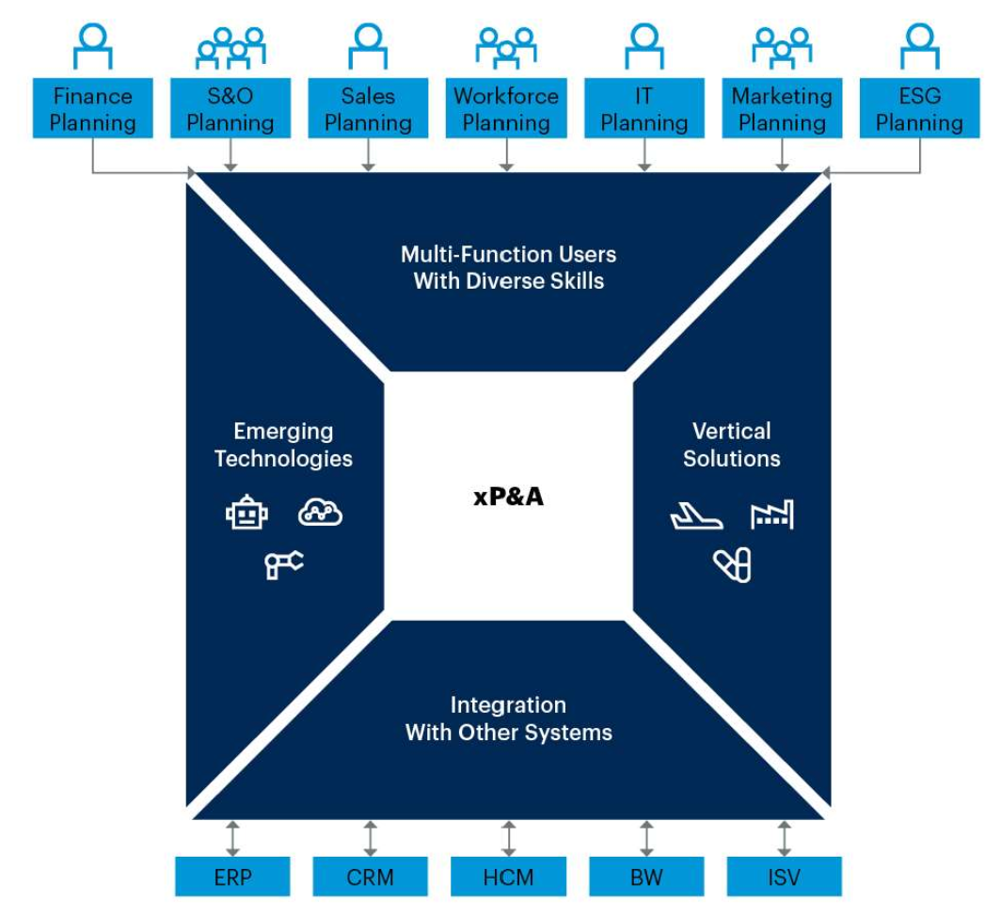
Four dimensions of xP&A are emerging that will affect user adoption
The four dimensions of xP&A
Dimensions overview
1. Multi-discipline functionality capabilities
Solutions track performance versus target at both department and organizational levels with forecast updated by one function affecting the outcome of others
Departments tend to look for specific solutions, often fostering selection of ‘best-of-breed’ / specialized players instead of integrated enterprise planning solutions / xP&A
1
2. Vertical specialty to understand industry needs
xP&A solutions are broadening their scope by incorporating industry-specific features
Nonetheless, XP&A may not fully replace best-of-breed solutions that are uniquely designed for specific industry planning needs
3
2
3. Emerging technologies and data modelling capabilities
Use cases for AI and ML are growing as uses and systems investigate how they can be used and where they can deliver robust data and assist with predictions
ML and AI technologies are not out-of-the-box solutions and require expertise for accurate projections
4
4. Ease of integration with other systems
xP&A solutions often require various degrees of integrations with other systems such as ERP, CRM and HCM
The more composable the xP&A platforms are, the easier it is to share data, resulting in increased adoption and better insights
As the use of open APIs evolves, it is expected for this dimension to be less relevant
Source: Gartner, AQMEN
5

Slide 6

xP&A market can be broken down by geography and type of customer
<(15%)
(15%)-(5%)
(5%)-5%
5%-15%
>15%
Certainty level of assumptions
Low
Medium
High
xP&A value tree
Sources for assumptions
Corporate - can also be broken down by industry type as it impacts mainly adoption and company size distribution
1A
1B
Total addressable market
Corporate
Global
# of customers
# of companies
Refers to the total number of potential users
Reliable sources from public entities (e.g. World Bank, CIA, etc)
+
x
x
1A
$mn
$mn
customers
companies
Large
Penetration rate
2A
$mn
Average Revenue per Customer
3A
%
2A
2B
Penetration rate
xP&A market by geography
Medium
$/customer
Refers to the level of adoption for each customer group (customers / total potential customers)
Estimated through interviews to customers and potential customer as there are no publicly available data
+
$mn
$mn
Small
North America, LatAm, Europe, MEA, APAC
$mn
# of customers
# of people
3A
3B
Average Revenue
x
1B
Personal - can also be broken down by demographics (age group and affluence level) it impacts mainly adoption average revenue per customer
Personal
customers
people
Refers to the average paid by customer. Is a function of number of licences hired as well as number of services
Estimated via interviews to customers as well as by gathering pricing data from companies themselves
+
Penetration rate
Average Revenue per Customer
2B
$mn
3B
%
$/customer
Source: AQMEN
6

Slide 7
xP&A market size is estimated at ~$14.4bn in 2023
<(15%)
(15%)-(5%)
(5%)-5%
5%-15%
>15%
FIGURES ARE DIRECTIONAL
xP&A market size, 2023 $m
Key takeaways
14,356
(100.0%)
North America and APAC represent ~2/3 of the total market
Large and Global segments account for more than half of both markets, expected given regions’ large economies hosting big enterprises
Overall, global, large and medium account for ~2/3 of the market
Segments have high penetration rates and higher revenue per customer as an increased number of licenses and modules are hired
Personal represents <10% of the market, mostly driven by low penetration and considerably lower revenue per customer
3,506 (24.4%)
534 (3.7%)
3,934 (27.4%)
5,384 (37.5%)
998 (7.0%)
Global
938
113
5,068
(35.3%)
1,500
2,181
338
90
Large
600
180
3,051 (21.3%)
150
960
1,221
3,172
(22.1%)
Medium
1,125
225
86
800
872
1,867
(13.0%)
516
135
Small
690
440
1,197 (8.3%)
96
594
120
Personal
154
234
NorthAmerica
LatAm
Europe
APAC
MEA
Source: Gartner, IDC, Statista, AQMEN
7

Slide 8
There are 7 key trends that will impact xP&A market going forward
Variable Impacted
Type of impact
Trend
Description
Rationale
1. Incorporation of new technologies
The incorporation of artificial intelligence, machine learning, and robotic process automation will driving significant improvements in analytics
Allows companies to harness the power of new technologies
Penetration
Increase
2. Migration to cloud
The shift towards cloud technologies is enhancing scalability, flexibility, and cost-efficiency for xP&A solutions
Capture into white space of companies with legacy products
Penetration
Increase
3. Security and compliance
With the growing volume of financial data and stringent regulatory requirements, ensuring data security and compliance is becoming more critical.
Reduce reproting friction and risk of penalties
Penetration
Increase
4. Real time data
Real-time budgeting, planning, and reporting, allowing businesses to respond swiftly to market changes
More companies hiring solutions as getting real time P&L (among others) becomes market practice
Penetration
Increase
5. ESG reporting
Increased incentives for companies reporting ESG, e.g. Carbon emissions
New modules hired
Price
Increase
6. Breaking silos
Enhanced collaboration across departments, facilitated by integrated xP&A solutions, is breaking down traditional silos and streamlining workflows
New modules hired
Price
Increase
7. Reduced complexity of integrations
Reduced complexity as handling data becomes simpler
Reduces cost of installation and managing solutions
Price
Decrease
Source: Gartner, IDC, Statista, AQMEN
8

Slide 9
xP&A market is expected to accelerate in the next 5 years, growing by +15%p.a., from +7% p.a. from 2018 to 2023
<(15%)
(15%)-(5%)
(5%)-5%
5%-15%
>15%
FIGURES ARE DIRECTIONAL
xP&A market size by category, $bn
Key takeaways
Corporate
Personal
Corporate represents +90% of the market and is expected to grow at ~16% p.a. from 2023 to 2024
The acceleration from 2018 to 2023, at 7% p.a., can be explained by an increase in penetration driven by technological advances reducing barriers to entry
Migration to cloud and AI adoption are expected to reduce not only the implementation hassles but also the complexity of usage
Personal segment will continue to grow at a historical pace driven by a combination of an increase in its addressable market and penetration rates
CAGR
18-23
CAGR
23-28
29.5
+15.5%
26.1
22.9
19.9
17.0
7.0%
15.7%
+7.5%
27.3
13.4
14.4
24.1
11.7
12.5
21.1
10.0
10.8
18.3
15.6
11.6
12.4
13.2
9.4
10.1
10.8
13.1%
13.2%
0.6
0.7
0.9
1.0
1.1
1.2
1.4
1.6
1.8
2.0
2.2
2018
2019
2020
2021
2022
2023
2024
2025
2026
2027
2028
Source: Gartner, IDC, Statista, AQMEN
9

Slide 10
Within the corporate segment, SMEs are expected to grow the fastest as they combine an increase in quantity and penetration
FIGURES ARE DIRECTIONAL
xP&A market size by type of corporate customer, $bn
Key takeaways
Global
Large
Medium
Small
Personal
SMEs will see the fastest growth for 2023 to 2028 at 19.2% and 29.3% respectively
Such a segment is currently underserved as companies struggle to allocate resources to the implementation of xP&A solutions
The market will soon demand functionalities beyond Excel capabilities, triggering an increase in penetration of SMEs, the segment with the largest addressable market by number of companies
CAGR
18-23
CAGR
23-28
29.5
+15.5%
26.1
6.5
4.4%
5.1%
22.9
6.2
19.9
4.9
5.8%
9.9%
5.9
+7.5%
17.0
5.6
4.5
13.4
14.4
5.3
4.1
13.0%
29.3%
11.7
12.5
3.7
11.4
10.0
10.8
4.9
5.1
9.6
4.5
4.7
3.4
7.8
4.1
4.3
3.1
6.2
8.0%
19.2%
2.6
2.7
2.9
4.6
2.3
2.4
2.9
3.2
4.5
1.7
2.0
2.3
2.6
2.8
3.3
3.9
13.1%
13.2%
1.3
1.4
1.5
1.6
1.7
1.9
2.3
0.6
0.7
0.9
1.0
1.1
1.2
1.4
1.6
1.8
2.0
2.2
2018
2019
2020
2021
2022
2023
2024
2025
2026
2027
2028
Source: Gartner, IDC, Statista, AQMEN
10

Slide 11
Within the corporate segment, SMEs are expected to grow the fastest as they combine an increase in quantity and penetration
<(15%)
(15%)-(5%)
(5%)-5%
5%-15%
>15%
FIGURES ARE DIRECTIONAL
xP&A market size by corporate geography, $bn
Key takeaways
NorthAmerica
LatAm
Europe
APAC
MEA
LatAm will experience the fastest growth, yet still represent a small part of the market
North America growth is expected to be 18.7% p.a., driven by both increase in prices as well as a growth in companies within the SME segment
North America is poised to see a surge in tech companies, leveraging the tailwinds of GenAI
New companies, born on the cloud, will be prone to adopt xP&A solutions early on
CAGR
18-23
CAGR
23-28
29.5
+15.5%
26.1
7.9%
18.7%
8.2
22.9
7.2
19.9
6.2
1.2
8.0%
19.0%
17.0
5.2
1.0
+7.5%
0.9
7.8
6.8%
14.7%
13.4
14.4
4.3
0.8
7.0
11.7
12.5
3.5
0.6
6.2
10.0
10.8
3.0
3.3
0.5
5.4
2.6
2.8
0.5
0.5
4.6
2.4
0.4
0.4
3.7
3.9
6.5%
13.8%
0.4
3.0
3.3
3.5
9.1
10.2
2.8
7.1
8.1
4.7
5.0
5.4
6.2
3.8
4.1
4.4
7.1%
16.4%
0.7
0.7
0.8
0.9
0.9
1.0
1.2
1.4
1.6
1.8
2.1
2018
2019
2020
2021
2022
2023
2024
2025
2026
2027
2028
Source: Gartner, IDC, Statista, AQMEN
11

Slide 12
Agenda
Market Overview
Competitive Landscape
About Aqmen

Slide 13
xP&A market players are mostly defined by the size of customers they serve and the number of services they offer
Broadness of Service Offering
Target customer size
Category
Description
Category
Description
Specific
Service offering including a limited number of solutions
Often focusing on FP&A and OP&A (Operations Planning and Analyses)
Personal
Individuals
Personal or household / small cohort uses
Broad
Integrated solution offering
Includes modules for various functions within an organisation (e.g. HR, Sales Planning, etc.)
Small
Annual revenues with less than $50m
Number of employees with less than 100
Medium
Annual revenues between $50m and $1bn
Number of employees between 100 and 999
Large
Annual revenues between $1bn and $5bn
Number of employees between 1,000 and 10,000
Global
Annual revenues with more than $5bn
Number of employees more than 10,000
13

Slide 14
xP&A market players can be allocated to 5 main archetypes
xP&A market matrix, service offering vs customer size
Archetype definition
Target customer size
Category
Description
Traditional IT Service companies
Traditional companies which started either doing ERP, Software or Hardware solutions and expanded into service solutions
1
Global
3
2
1
+
Best-of-Breed niche players
New Incumbents / Disruptors
Traditional IT Service companies
New Incumbents / Disruptors
2
Companies recently created (born in the cloud), that have identified an opportunity to disturb the market by offering solutions leveraging latest trends
Large
Best-of-Breed niche players
Companies focusing either on industry verticals (e.g. Retail) and / or solution specific (FP&A)
Medium
3
4
SME focused solutions
SME focused solutions
Companies targeting mostly SMEs through a limited-service offering, often around FP&A and OP&A
Small
4
-
Personal
Personal focused solutions
Companies serving individuals who are mostly looking for FP&A solutions around treasury management and financial planning
Personal focused solutions
5
5
Limited to no market¹
Specific
-
+
Broad
Broadness of Service Offering
Note: 1- Personal (Individuals) don’t require as many modules as enterprises do (e.g. HR management). Often solutions centre on Treasury Management and Financial Planning
14
Source: AQMEN

Slide 15















xP&A market is highly fragmented, especially in the SMEs space (1/3)
FIGURES ARE DIRECTIONAL
NOT EXHAUSTIVE
Company
Year Founded
HQs
PE Backed?
# Employees. 2023 Est
xP&A Sales, 2023 $m Est
Description
1911
Armonk, USA
N.M.
+10,000
~3,100
IBM provides a suite of analytics tools and solutions that support financial planning, analysis, and decision-making for large enterprises.
IBM
1972
Walldorf, Germany
N.M.
+10,000
~5,400
SAP offers integrated financial planning and analysis solutions within its broader enterprise resource planning (ERP) suite, supporting comprehensive business planning.
SAP
1. Traditional IT Service companies
1968
Alphen aan den Rijn, Netherlands
N.M.
+10,000
~3,200
Wolters Kluwer's CCH Tagetik provides corporate performance management solutions that help businesses with budgeting, planning, financial close, and consolidation.
Wolters Kluwer
1977
Redwood Shores, USA
N.M.
+10,000
~2,500
Oracle provides a comprehensive suite of enterprise performance management applications that support financial planning, consolidation, and analytics.
Oracle
2005
Pleasanton, USA
N.M.
+10,000
~3,100
Workday provides an enterprise cloud application for finance and HR that supports planning, execution, and analysis within a single system.
Workday
2006
San Francisco, USA
Yes - Thomas Bravo (2024)
~3,000
~300
Anaplan provides a cloud-native platform for planning and performance management that connects data, people, and plans across businesses, enabling dynamic planning.
Anaplan
2010
Rochester, USA
Yes - KKR (2019)
~3,000
~300
OneStream offers a unified, intelligent finance platform for corporate performance management, integrating planning, reporting, and analytics.
OneStream
2. New Incumbents / Disruptors
2018
Raleigh, USA
Yes- TA Associates (2018)
~3,000
~200
Insight Software offers financial reporting and performance management solutions that integrate with ERP systems to provide real-time insights.
Insight Software
1994
Chiasso, Switzerland
Yes - Nordic Capital (2019)
~750
~150
Board offers an all-in-one decision-making platform that integrates business intelligence, corporate performance management, and predictive analytics.
Board International
2019
Paris, France
Yes - ICONIQ / Felix Capital & Others (2024)
~175
~50
Pigment is a business planning platform designed to provide a better way to model, plan, and forecast, offering rich visualizations and real-time data analytics.
Pigment
Source: Crunchbase, Gartner, Company Websites
15

Slide 16
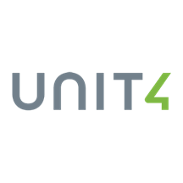











xP&A market is highly fragmented, especially in the SMEs space (2/3)
FIGURES ARE DIRECTIONAL
NOT EXHAUSTIVE
Company
Year Founded
HQs
PE Backed?
# Employees. 2023 Est
xP&A Sales, 2023 $m Est
Description
1980
Utrecht, Netherlands
Yes - TA Associates (2014)
~3,000
~750
Unit4 provides enterprise software solutions that include financial planning, analysis, and performance management tailored for people-centric organizations.
Unit4
2020
Chicago, USA
Indirectly - CD&R (2023)
~375
~75
Syntellis specializes in enterprise performance management solutions for healthcare, higher education, and financial institutions.
Syntellis
3. Best-of-Breed niche players
2000
Redwood City, USA
Yes - Vector Capital (2018)
~375
~30
Planful delivers an end-to-end cloud FP&A platform that accelerates planning cycles and enhances collaboration and data-driven decision-making.
Planful
1987
Mississauga, Canada
Yes - HG Capital (2021)
~750
~30
Prophix provides corporate performance management software that supports budgeting, forecasting, reporting, and financial consolidation.
Prophix
2002
Natick, USA
Yes - Scaleworks (2022)
~75
~30
Centage specializes in budgeting, forecasting, and planning software for small and medium-sized businesses, focusing on ease of use and rapid deployment.
Centage
2018
New York, USA
Yes - Databricks, Bain Capital Ventures & Others (2024)
~175
~30
Cube Software delivers a cloud-based FP&A platform designed to simplify complex financial processes and enhance data accuracy.
Cube Software
2002
Freiburg, Germany
Yes - Insight Partners (2021)
~175
~30
Jedox is a cloud-based planning, analysis, and reporting platform that supports enterprise performance management and integrates with various data sources.
Jedox
4. SME focused solutions
2011
Toronto, Canada
Yes - Vista Equity Partners (2021)
~375
~30
Vena Solutions offers a complete planning platform that combines Excel with the power of the cloud for budgeting, forecasting, and reporting.
Vena Solutions
2015
Singapore
No
~31
~10
Just Perform focuses on performance management solutions that streamline planning, budgeting, and forecasting processes.
Just Perform
2009
Seattle, USA
No
~75
~10
Kepion provides planning, budgeting, and forecasting solutions that integrate with Microsoft BI tools for enhanced data visualization and analysis.
Kepion
Source: Crunchbase, Gartner, Company Websites
16

Slide 17








xP&A market is highly fragmented, especially in the SMEs space (3/3)
FIGURES ARE DIRECTIONAL
NOT EXHAUSTIVE
Company
Year Founded
HQs
PE Backed?
# Employees. 2023 Est
xP&A Sales, 2023 $m Est
Description
2014
Toronto, Canada
No
~30
~10
Limelight Software delivers a cloud-based FP&A platform that enhances collaboration and real-time planning for finance teams.
Limelight Software
2006
Mountain View, USA
No
~5,000
~1,500
Mint is a popular personal finance app that helps users manage their money, create budgets, and track spending and savings goals.
Mint
Personal Capital
2009
Redwood City, USA
No
~375
~300
Personal Capital offers a comprehensive financial planning and wealth management platform for individuals, integrating budgeting, investment tracking, and retirement planning.
2004
Lehi, USA
No
~175
~75
YNAB focuses on budgeting and personal financial management to help users allocate their income towards expenses, savings, and debt repayment.
YNAB
5. Personal focused solutions
Money-GuidePro
1997
Powhatan, USA
No
~175
~30
MoneyGuidePro provides financial planning software primarily used by financial advisors but also accessible to individual users for comprehensive financial planning.
1983
Menlo Park, USA
Yes - Aquiline Capital Partners (2021)
~175
~30
Quicken provides personal finance software that helps users manage their finances, track spending, and plan budgets.
Quicken
2022
Barcelona, Spain
No
~10
~10
BankTrack provides information and tools for users to manage their personal finances, track their spending, and understand the impact of their financial decisions.
BankTrack
Source: Crunchbase, Gartner, Company Websites
17

Slide 18
There are 9 key purchasing criteria, which present some variance within customer categories
Category
Description
Avg. Score
Score per category (1=lowest, 5=highest)
1. Cost and ROI
Total cost of ownership (including licensing, implementation and other costs), and its return on investment
2. Integration and Data Management
Ability to integrate seamlessly with other systems providing accurate, consistent and real-time data
3. Functionality and Features
Good coverage of key basic functionalities: comprehensive planning, scenario modelling and predictive analytics, driver-based planning, budgeting and forecasting and financial consolidation
4. Implementation and Support
Ease of implementation and vendor support and training
5. User Experience
Ease of use, including collaboration tools across department and teams, and customization and flexibility
6. Security and Compliance
Robust data security and compliance with relevant financial regulations and standards
7. Vendor Reputation and Market Presence
Vendor with financial stability and good market presence, and positive customer reviews and references
8. Scalability and Performance
Ability to scale with the organization accommodating increasing data volumes while maintaining high-performance processing large datasets and complex calculations
9. Innovation and Future Roadmap
Vendor's commitment to innovation and continues improvement
Global
Large
Medium
Small
Personal
18
Source: Gartner, Statista, AQMEN

Slide 19
Agenda
Market Overview
Competitive Landscape
About Aqmen

Slide 20
TIME IS TOO PRECIOUS TO WASTE ON REPETITIVE TASKS
At AQMEN we empower smarter decisions
We believe activities like business modelling should be streamlined, allowing people to focus on what truly adds value — thinking.
That’s why we created LIO, our productivity tool in the form of an AI assistant that guides users through complex problems, providing structure and actionable insights with tailor made ready-to-use outputs. Reaching Actionable Wisdom has never been easier
Through our ‘Due Diligence’ Module, LIO has been able to cut down due diligence setup time by over a third, enabling users to reach a ‘Day 1 answer’ in under five minutes (Yes, you read that right).
AQMEN was founded by seasoned industry professionals and a world-renowned academic. Our team brings deep sector expertise, startup experience, and advanced knowledge of cutting-edge technologies, including AI, machine learning, and graph analytics.
We’re looking for strategic partners. If you have the insights and connections to help drive AQMEN’s success, let’s talk.
20

Slide 21
Founded in 2024, Aqmen aims to reduce time and increase accuracy on achieving ‘Actionable Wisdom’
PURPOSE >
PROBLEM >
Why Aqmen exists?
What is Aqmen solving for?
TO DEMOCRATISE ACTIONABLE WISDOM
THE CURRENT PROCESS TO REACH ACTIONABLE WISDOM IS INNEFICIENT AND UNPRODUCTIVE
DEMOCRATISE: MAKE SOMETHING ACCESSIBLE
TIME-CONSUMING
WISDOM: ABILITY TO THINK AND ACT UNISNG KNOWLEDGE, EXPERIENCE, UNDERSTANDING, COMMON SENSE AND INSIGHT
REPETITIVE AND DRAINING
ACTIONABLE WISDOM: PRACTICAL APPLICATION OF WISDOM IN REAL-WORLD SCENARIOS.
THE BIRTHPLACE OF TRUE ACUMEN (AQMEN).
PRONE TO HUMAN ERROR
INFLEXIBLE AND HARD TO SCALE
21

Slide 22
1.1bn
38%
68%
94%
People in the world use Excel. In other words, more than 1 in 8 people in the planet uses Excel
Time spent by office workers using Excel
Of office workers considers their skills in Excel as Beginner or Intermediate
Of spreadsheets built by human’s contain errors (which can be very costly!)
JPMorgan Chase "London Whale" Trading Loss
Reinhart and Rogoff Study on Debt and Growth
Mizuho Securities Trading Error
Copy-pasting and formula errors in the spreadsheet led to incorrect risk calculations, contributing to a $6 billion loss. The spreadsheet accidentally averaged values instead of summing them, which drastically understated risk.
A formula error in their Excel sheet excluded data for some countries, leading to incorrect conclusions about the relationship between debt levels and economic growth
Mizuho Securities accidentally sold 610,000 shares at 1 yen instead of 1 share at 610,000 yen due to a spreadsheet error during a trade on the Tokyo Stock Exchange
Source: Microsoft Excel Statistics 2022, Acuity Training, What we know about spreadsheet errors
22

Slide 23
Aqmen’s first module targets professionals running Due Diligence process and aims to support them through its AI agent, Lio
MEET Lio
Lio is a productivity solution that can help user work through a problem and provide a structured solution. Lio has been trained to solve problems like a DD expert.
Lio will guide user through the three main stages of any task:
1. Problem-solving
Defining the scope, reach, and initial hypothesis.
2. Analytics
Structuring and running numbers to validate or refute the initial hypothesis.
Lio is Aqmen's AI-powered assistant
3. Communication
Conveying your findings in a crystal-clear way.
23

Slide 24
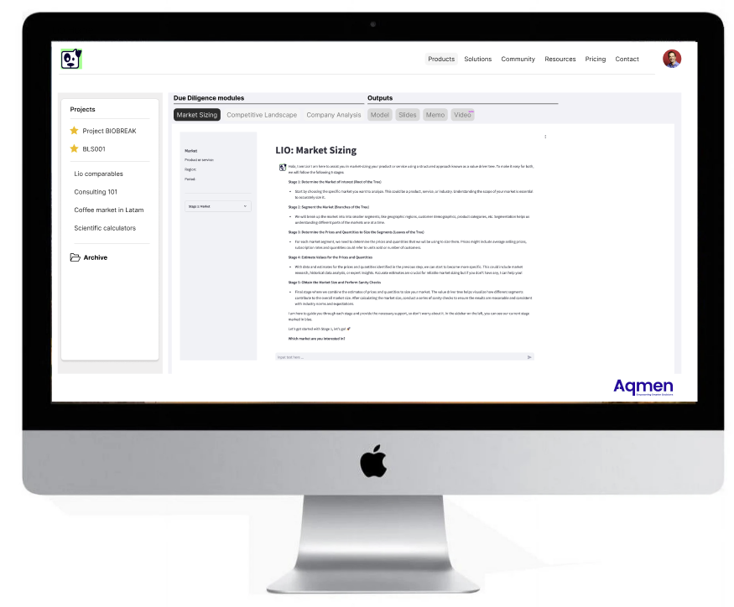
DDs are time-sensitive, high-stakes tasks requiring rapid, precise analysis
Deep-dive to follow
Overview of Aqmen's Due-Diligence module
Market Sizing
Market definition and sizing via a driver-tree approach
How big is the market, what are the different segments and how are they expected to grow and why
Competitive Landscape
Player mapping via a customer archetype approach
What are the different archetypes, what segment do they focus on and what is the estimate market share and trend
Company Analysis
Company assessment via a DCF / Business Plan approach
What case can we underwrite based on the company’s past performance, market and competitive landscape assessment
24

Slide 25
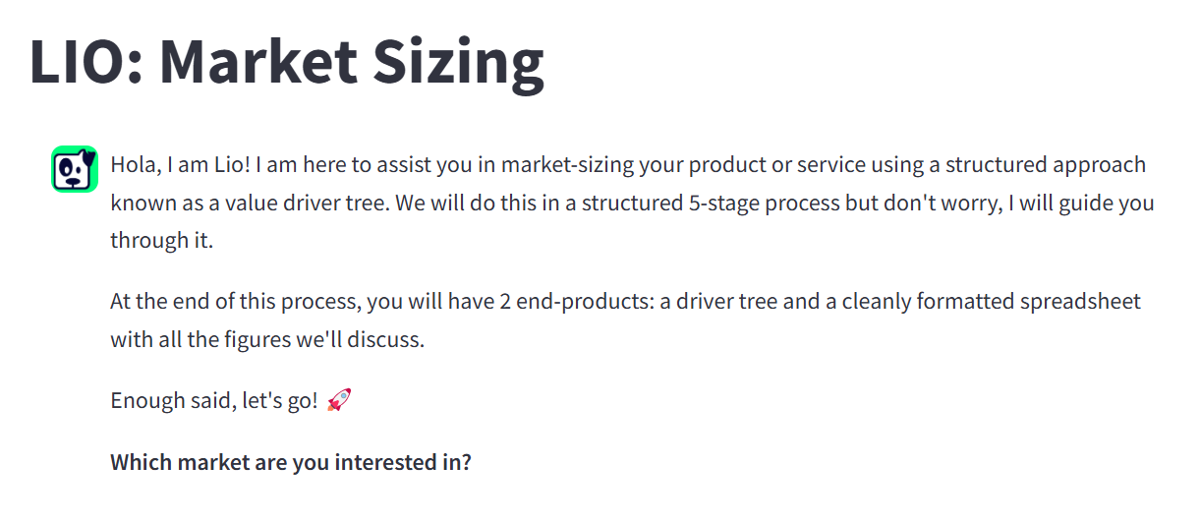
Lio allows users to size a market in under 5 min and cuts down DD setup times by a third
VALUE DRIVER TREE APPOACH – LIO’S 5-step process
1. Market
Define the ‘root’ market to assess
“I’m interested in Productivity Tools market”
Define the ‘branches’ in the market
2. Segments
“I’m interested in Analytics & Reporting, Workflow Automation and Task & Project Management”
Define the structure of the ‘leaves’
3. P and Q
“I want to do size the market from a demand side: Number of Subscriptions * Average Subscription Price
Define the value of the ‘leaves’
4. Assumptions
“For Quantity, I want to look at total companies by size and by region for the TAM and assess penetration to get to the SAM”
As easy as consulting a trusted expert who guides you in structuring and sizing a market using industry best practices.
5. Size and Sanity Check
Asses the outputs
“~$25bn for 2023 seems reasonable, let's do a quick bottom-up assessment as sanity check”
25

Slide 26
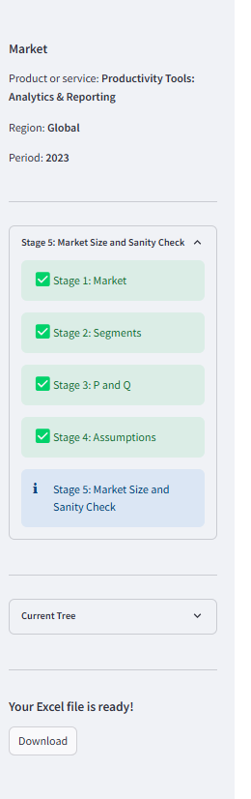
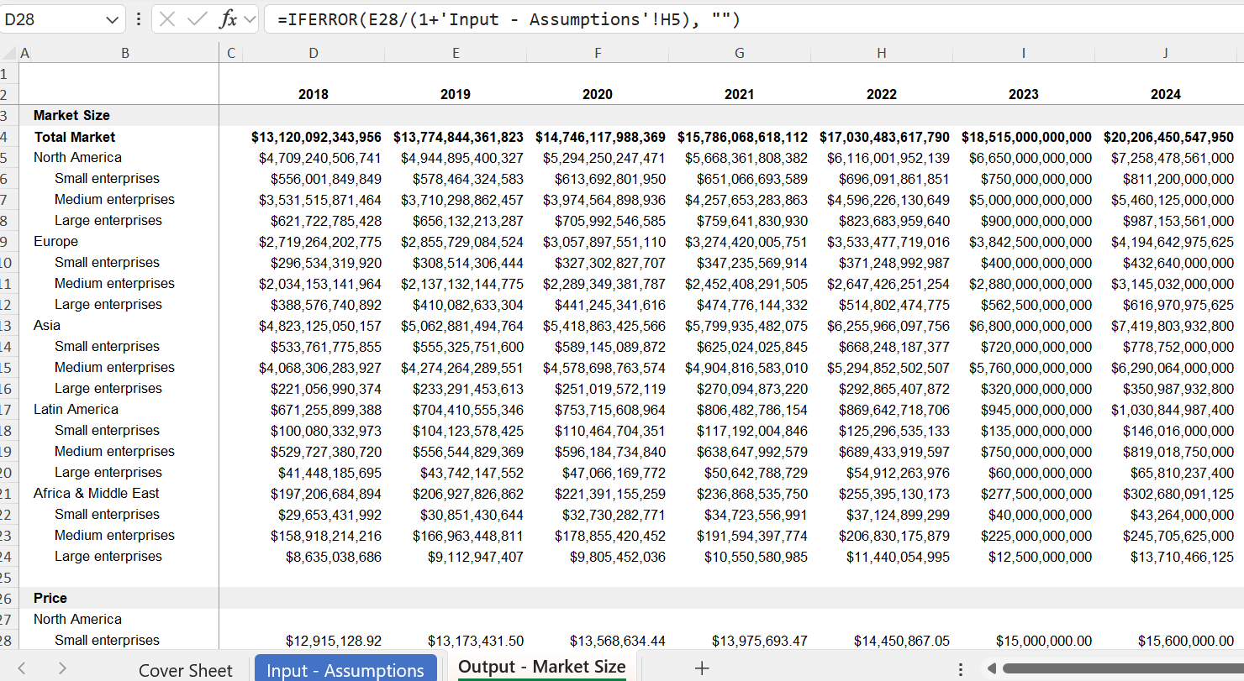
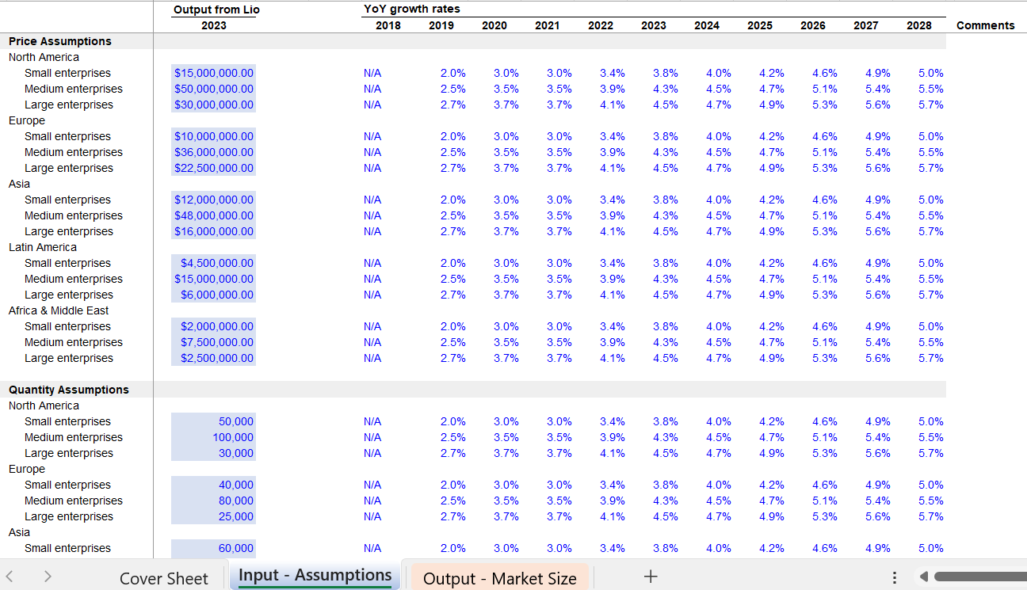
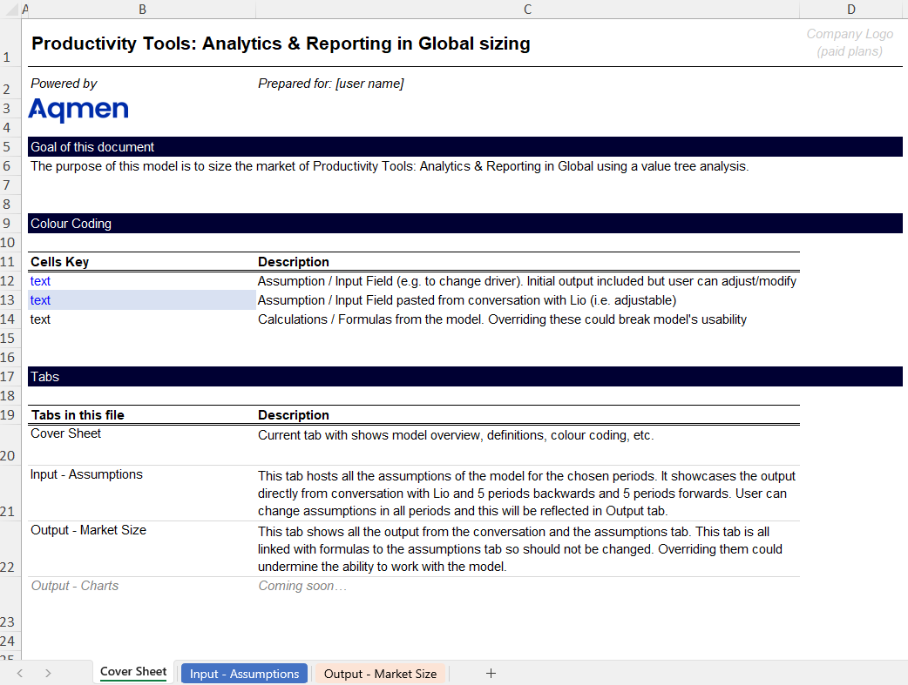
Contrary to other solutions, Aqmen allows users to iterate answers in native apps like Excel
Achieving the Day 1 answer in under 5 minutes, with a fully functional model to further refine assumptions
Outputs – Market Size
Inputs - Assumptions
Cover Sheet
Outputs with clear a structure and live formulas, not hard-coded!, allowing for overwrite if needed
Easy to navigate assumptions with no-room for human coding error
Following modelling best practices of tabs and colour coding
26

Slide 27






A Team Committed to Excellence
Miguel Casares
Felix Beccar
Santiago Segarra
Miguel is an experienced finance and operations executive with a comprehensive background in investment banking, strategic consultancy, and operational leadership. He recently served as the Head of European Operations at REEF Technology. Previously, he was a strategic consultant at McKinsey & Company, managing transformation projects and advising on value creation, as well as an Investment Banker at Itau BBA covering the LatAm market. Miguel holds an MBA from London Business School and Lactam an Industrial Engineering degree from Instituto Tecnológico de Buenos Aires.
Felix brings over +20 years of experience in finance, management consulting and tech. He recently served as CFO at Mural where he scaled the company from less than $10m to over $100m in ARR, led the company’s latest acquisition, and achieved cash break-even. He has held senior positions at Bain & Company and Hermes Management Consulting, and tech firms like LinkedIn and Pipedrive. Felix is renowned for his customer centric approach and a strong emphasis on user experience, all viewed through a Finance & Operations lens Felix holds an MBA from INSEAD and an Industrial Engineering degree from Instituto Tecnológico de Buenos Aires.
Santiago is a renowned academic and researcher with expertise in network theory, data analysis, machine learning, and graph signal processing. He is a tenured W. M. Rice Trustee Associate Professor at Rice University, with over 150 published papers and more than 4,000 citations. Santiago has received numerous awards, including the IEEE Signal Processing Society Young Author Best Paper Award and NSF CAREER. Santiago holds a Ph.D. in Electrical and Systems Engineering and an M.Sc. in Electrical Engineering from the University of Pennsylvania, and an Industrial Engineering degree from Instituto Tecnológico de Buenos Aires, where he graduated as Valedictorian.
27

Slide 28

Thank you
www.aqmen.ai

Slide 29
DISLCAIMER
This document has been prepared by Aqmen and is intended for internal use or distribution only with prior written approval from Aqmen. The information contained herein is based on publicly available data and is provided for informational purposes only.
The content does not constitute financial, investment, or business advice, nor should it be construed as a recommendation or endorsement of any specific strategy, company, or market. While reasonable care has been taken to ensure the accuracy of the information presented, Aqmen makes no representations or warranties, express or implied, regarding the completeness, reliability, or suitability of this document for any particular purpose.
Any reliance placed on the information in this document is strictly at the reader’s own risk. Aqmen accepts no liability for any loss or damage resulting from the use of this document or the information contained herein.
29

Slide 30
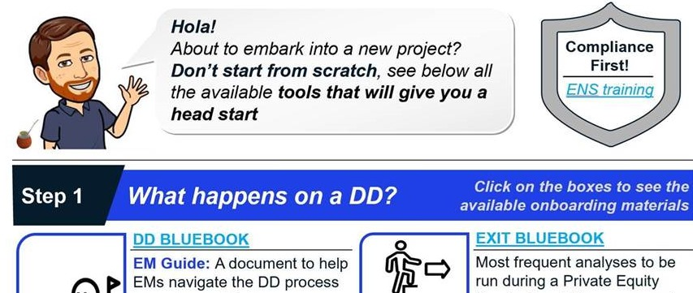
WE ARE NOT REPLACING EXCEL … FOR NOW
How are we solving the problem?
30

